Slide 1
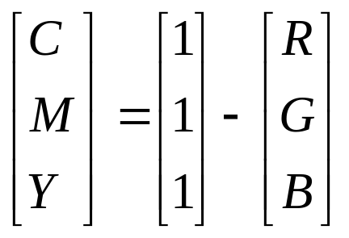
CMY and CMYK color models
Assume all color values are normalized to [0,1]
The CMY color model is used in connection with generating hardcopy output
CMY color model:
CMYK K is the fourth color, black; because equal amount of CMY produces a muddy-looking black, since black is the predominant color in printing, we need to produce true, pure black
Conversion from CMY to CMYK:
K = min(C,M,Y)
  if K = = 1 then t_{CMYK} = (0,0,0,1), else
  t_{CMYK} = (c, m, y, k) = ((C - K) / (1 - K), (M - K) / (1 - K), (Y - K) / (1 - K), K )
CUI, Lahore Campus -- CSC 331: Digital Image Processing -- © Dr. Usama Ijaz Bajwa

Slide 2
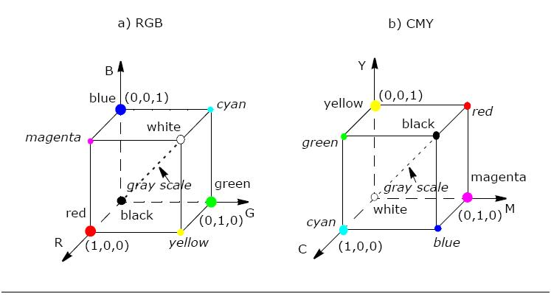
CMY and CMYK color models
CUI, Lahore Campus -- CSC 331: Digital Image Processing -- © Dr. Usama Ijaz Bajwa

Slide 3

YIQ (NTSC) color model
This model was designed to separate chrominance from luminance.
The Y-channel contains luminance information
the I and Q channels: in-phase and in-quadrature carry the color information.
A color television set would take these three channels, Y, I, and Q, and map the information back to R, G, and B levels for display on a screen.
In MATLAB: rgb2ntsc and ntsc2rgb
CUI, Lahore Campus -- CSC 331: Digital Image Processing -- © Dr. Usama Ijaz Bajwa

Slide 4
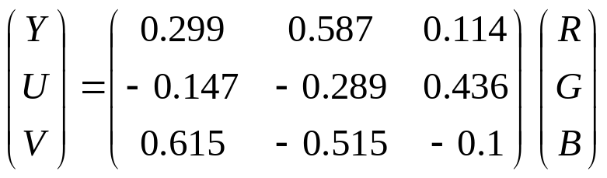
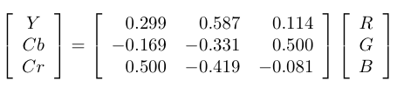
YUV (YCbCr) color model
YUV is used worldwide for TV and video encoding standards e.g. PAL, French SECAM and for JPEG/MPEG compression.
  YUV allows separating the color information from the luminance component
  A conversion of an RGB signal to YUV requires just a linear transform-easy to implement
Y: Luminance
U, Cb: Chroma channel, U axis, blue component
V, Cr: Chroma channel, V axis, red component
In MATLAB: rgb2ycbcr and ycbcr2rgb
CUI, Lahore Campus -- CSC 331: Digital Image Processing -- © Dr. Usama Ijaz Bajwa

Slide 5
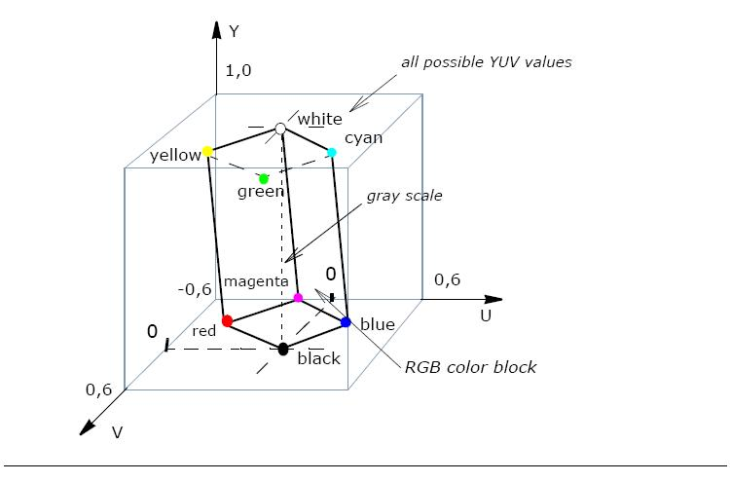
RGB Colors Cube in the YUV Color Space
CUI, Lahore Campus -- CSC 331: Digital Image Processing -- © Dr. Usama Ijaz Bajwa

Slide 6
HSI color model (HSB/HSV)
RGB and CMY are not well suited for describing colors for human interpretation
Hue (H), saturation (S), and intensity (I)
  Hue: color attribute that describes a pure color (e.g., pure yellow or red)
  Saturation: a measurement of the degree to which a pure color is diluted by white light
  Intensity can be decoupled from the color information (H and S)
HSI is ideal for processing color image based on the color sensing properties of the human visual system
I (intensity):
The line joining vertex (0,0,0): black and vertex (1,1,1): white.
All points along this axis are gray.
CUI, Lahore Campus -- CSC 331: Digital Image Processing -- © Dr. Usama Ijaz Bajwa

Slide 7
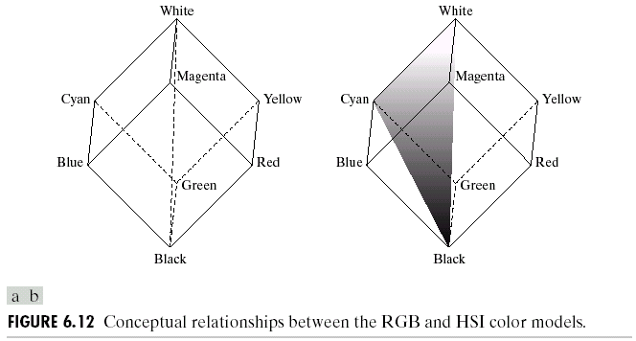
HSI color model
H (hue)
All points in the plane defined by black, white, and color_{a} have the same hue (color_{a})
CUI, Lahore Campus -- CSC 331: Digital Image Processing -- © Dr. Usama Ijaz Bajwa

Slide 8
HSI color model
S (saturation)
To determine the saturation (purity) of color_{a}, draw a plane containing color_{a} and perpendicular to the intensity axis and have the same hue (color_{a});
Saturation is the perpendicular (shortest) distance between the point color_{a} and the intensity axis
Thus, the hue, saturation, and intensity values required to form the HSI space can be obtained from the RGB color cube.
In MATLAB: rgb2hsv and hsv2rgb
CUI, Lahore Campus -- CSC 331: Digital Image Processing -- © Dr. Usama Ijaz Bajwa

Slide 9
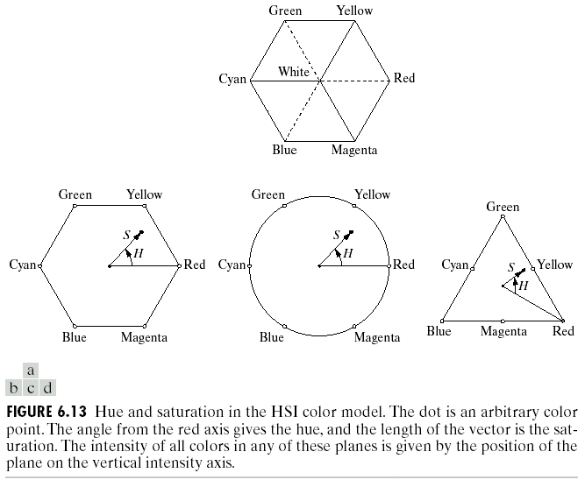
HSI color model
CUI, Lahore Campus -- CSC 331: Digital Image Processing -- © Dr. Usama Ijaz Bajwa

Slide 10
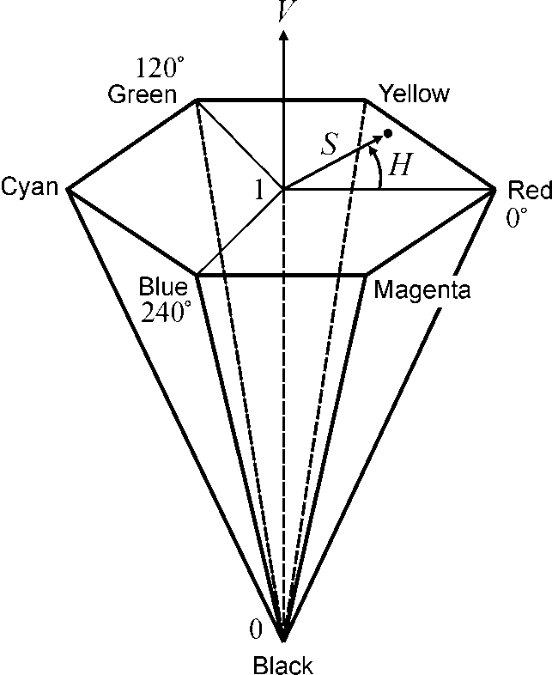

HSI color model
CUI, Lahore Campus -- CSC 331: Digital Image Processing -- © Dr. Usama Ijaz Bajwa

Slide 11
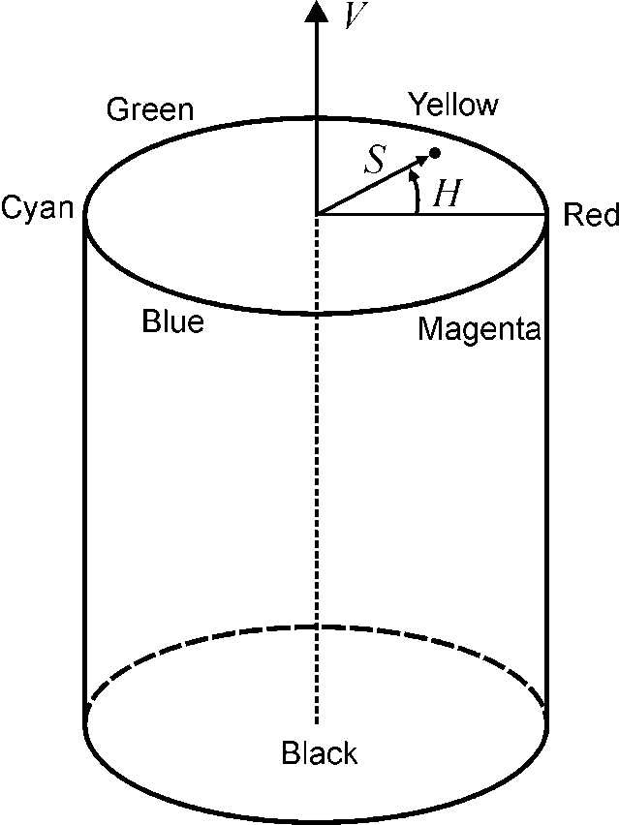
HSI color model
CUI, Lahore Campus -- CSC 331: Digital Image Processing -- © Dr. Usama Ijaz Bajwa

Slide 12

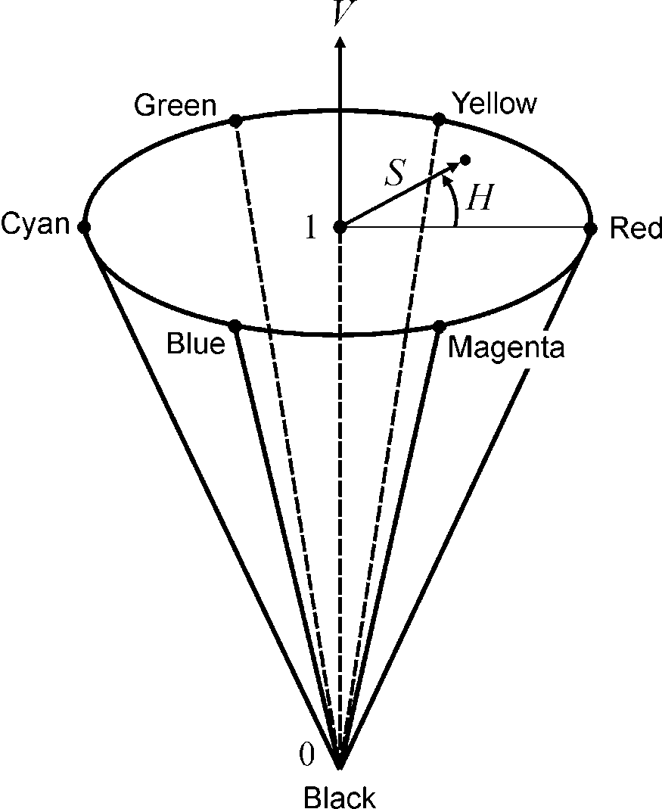
HSI color model
CUI, Lahore Campus -- CSC 331: Digital Image Processing -- © Dr. Usama Ijaz Bajwa

Slide 13
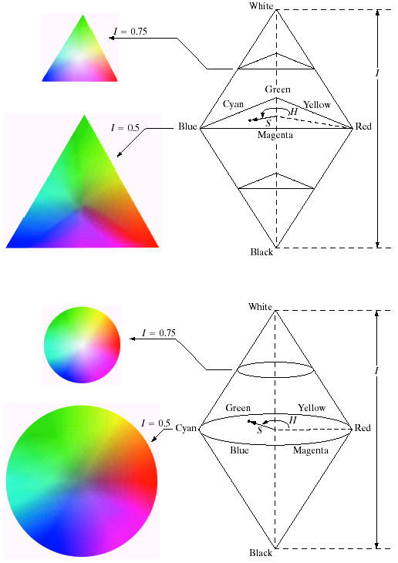
HSI color model
Triangular color plane perpendicular to the vertical intensity axis
Circular color plane perpendicular to the vertical intensity axis
CUI, Lahore Campus -- CSC 331: Digital Image Processing -- © Dr. Usama Ijaz Bajwa

Slide 14
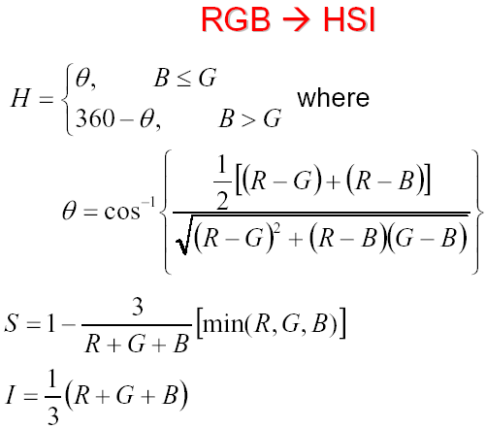
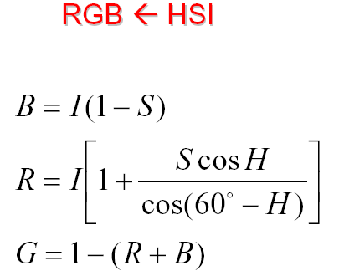



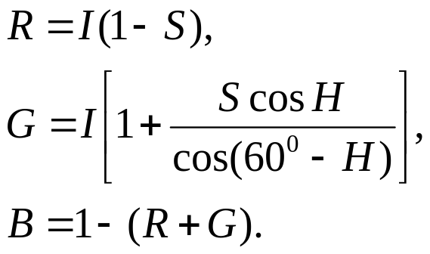
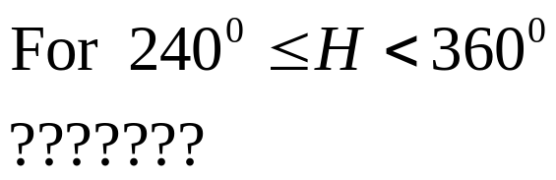
Conversion between RGB and HSI models
CUI, Lahore Campus -- CSC 331: Digital Image Processing -- © Dr. Usama Ijaz Bajwa

Slide 15
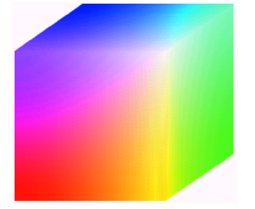
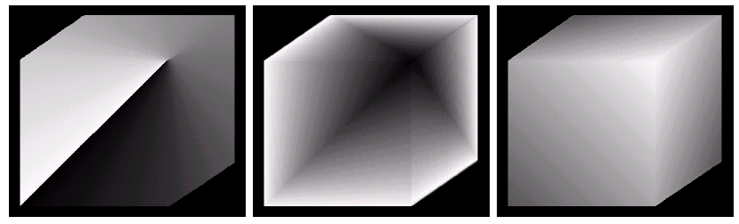
Conversion between RGB and HSI models
RGB image
Corresponding Hue image
Saturation image
Intensity image
CUI, Lahore Campus -- CSC 331: Digital Image Processing -- © Dr. Usama Ijaz Bajwa

Slide 16
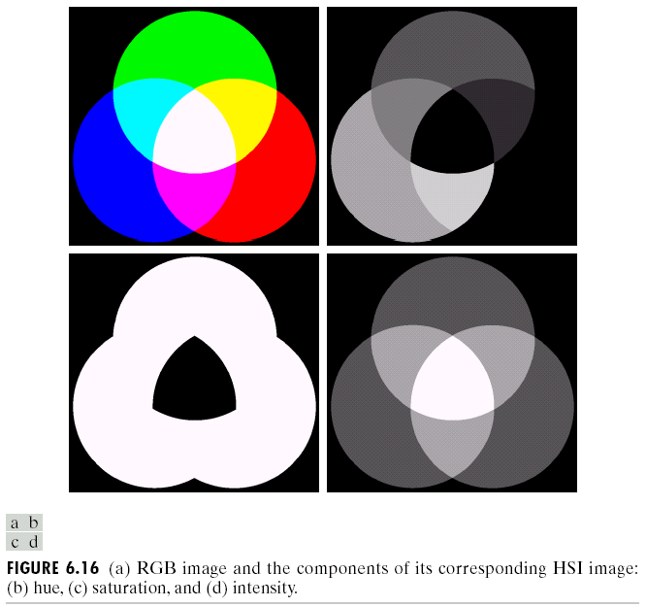
Manipulating HSI Component images
CUI, Lahore Campus -- CSC 331: Digital Image Processing -- © Dr. Usama Ijaz Bajwa

Slide 17
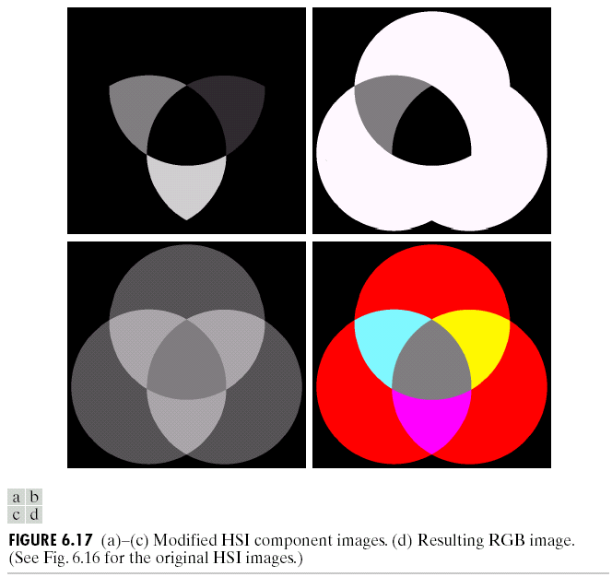
Manipulating HSI Component images
CUI, Lahore Campus -- CSC 331: Digital Image Processing -- © Dr. Usama Ijaz Bajwa

Slide 18
Manipulating HSI Component images
http://www.color-blindness.com/color-name-hue/
CUI, Lahore Campus -- CSC 331: Digital Image Processing -- © Dr. Usama Ijaz Bajwa

